Slide 1
Hoop
challenges

Slide 2
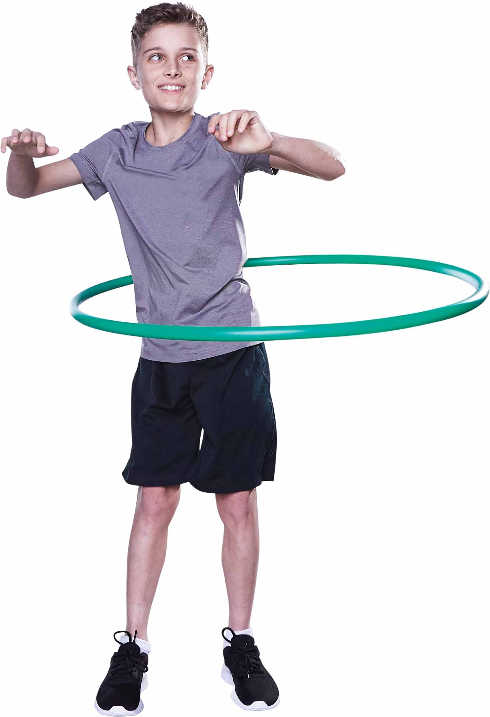
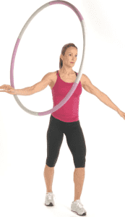
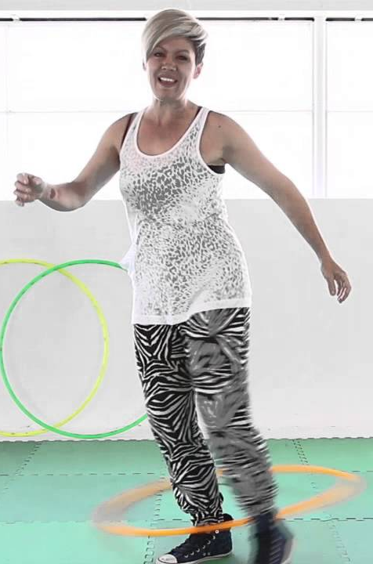
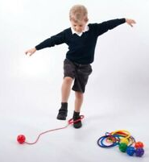
Hula Hooping
Hula hoop for as long as possible (I suggest
that you set a maximum time limit of 1 minute)
The challenge could be: -
Around the middle
Around 1 arm
Around 2 arms
Or use the foot hula hoop ankle ball

Slide 3
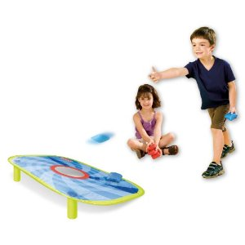
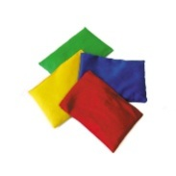
BEANBAG AIMING
How many bean bags can you get into the hoops?
1 point for throwing into
2 points for throwing into
3 points for throwing into

Slide 4
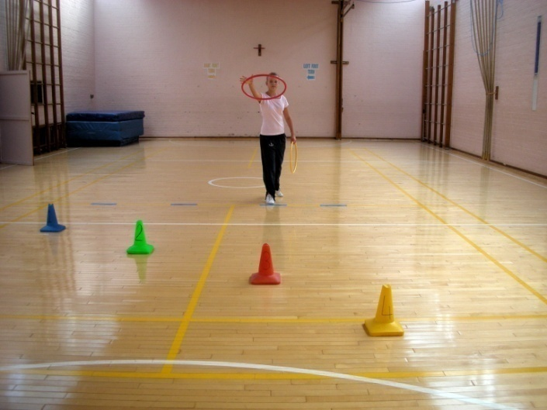
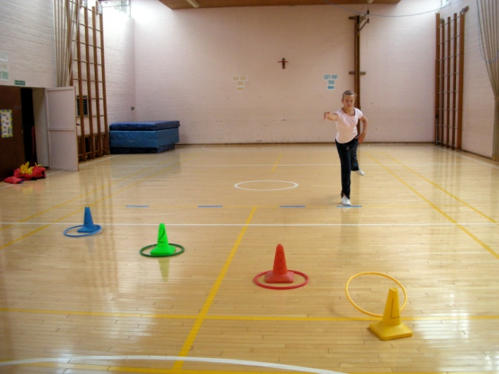
Hoopla
Stand behind a line and throw your hoop over the cones/tins.
The nearest cone scores 1 point and the furthest one away scores 4 points.
Have 10 attempts and see how many points you can score.

Slide 5
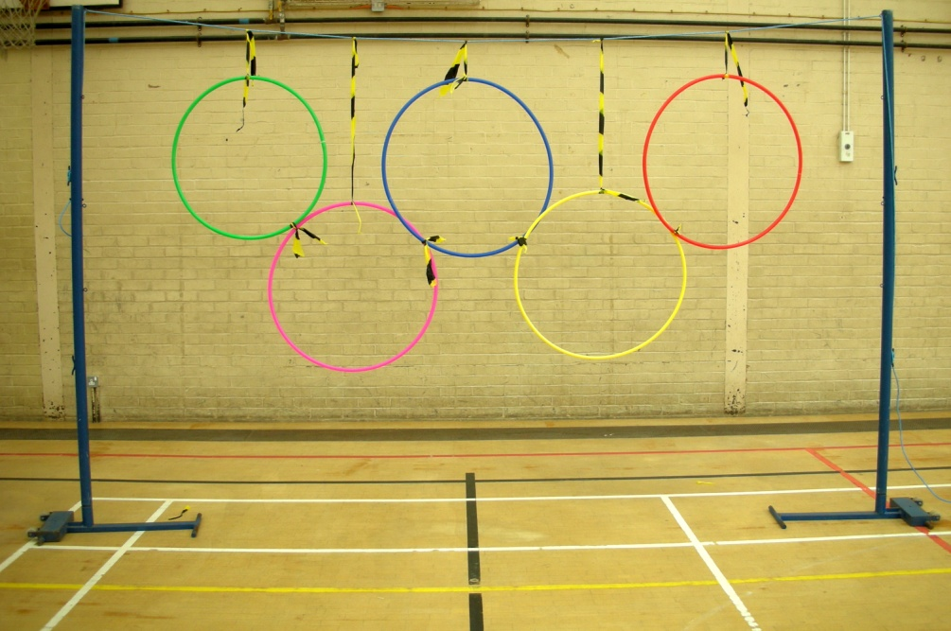
The Olympic rings
Tie some hoops onto a fence/draw some circles onto a wall
You have to throw 5 things through separate hoops:
You could throw: -
tennis ball
football
pair of socks
scrunched up paper
shoe
(anything that is not breakable)

Slide 6
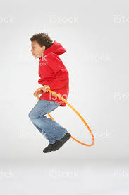
Hula skipping
A big hoop is easier for this challenge
Start with the hoop behind your feet and swing
the hoop over your head
Try walking through the hoop
Then jump through the hoop
See how many continuous skips you can manage
Try jumping: -
with feet together
Alternate feet
Hopping
Now try all of the above but send the hoop backwards

Slide 7
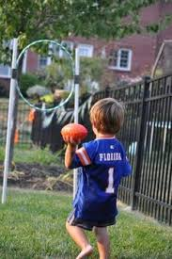
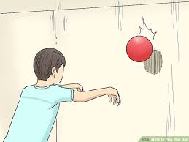
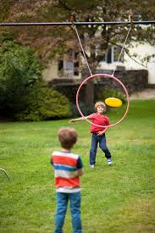
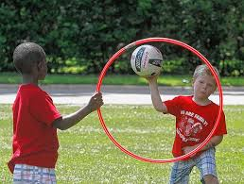
Throw through
Throw a ball or a pair of socks rolled up
or a frisbee through a hoop OR aim at
a wall where you’ve drawn a circle.
Try throwing: - underarm
overarm
with your right hand
with your left hand
with both hands
Perhaps someone else in your family
would like to join in your game.
They could hold the hoop for you OR
you could dangle the hoop from a
washing line and throw the ball/socks/
frisbee through the hoop.

Slide 8
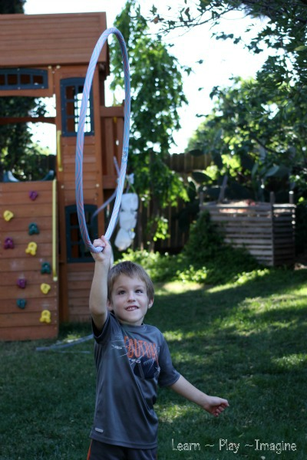
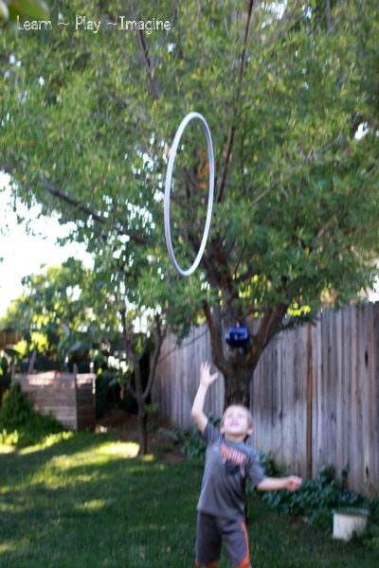
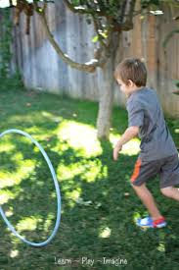
Throwing the hula hoop
Throw the hoop up into the air.
Can you throw it with your right and your left hand?
Can you catch it with two hands?
Can you catch it with your left hand?
Can you catch it with your right hand?
Ask another family member to throw and catch the
hoop with you. (Repeat the previous challenges).
Try rolling the hoop by your side.
How long can you keep rolling it?
Can you roll the hoop away and then try to run past it
before it falls?
Can you spin the hoop as you throw it along the
Ground? It should come back to you!

